Slide 1
ss

Slide 2
Flowering of cultured science
During the reign of Asoka (304-232bce) the 3 Dravidian dynasts of chola chera Pandya ware ruling the south.
Sangam period is the period is te period of ancient Tamil nadu and kerla spanning from 6th century BCE and 1st century CE .
Harshavrdana ruled north India from 606 from 647 CE

Slide 3
India from 4century to 7century

Slide 4
Chandra gupta i
320-335 ce l
He extended his spot by encroaching ouhd luhd bihar and aalhabad
He got title of king of kings he was succeed by his son samudragupta

Slide 5
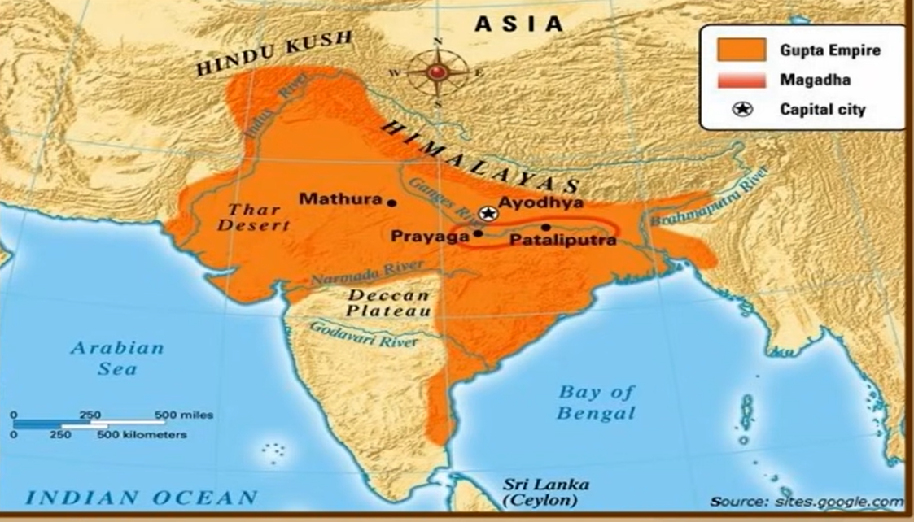
samudragupta
335-375 ce
He folloed the policies of comquest and expantion
He is called nepolion of india
He conquered 75% of india
He is a munition
He was succeeded by Chandra gupta 2

Slide 6
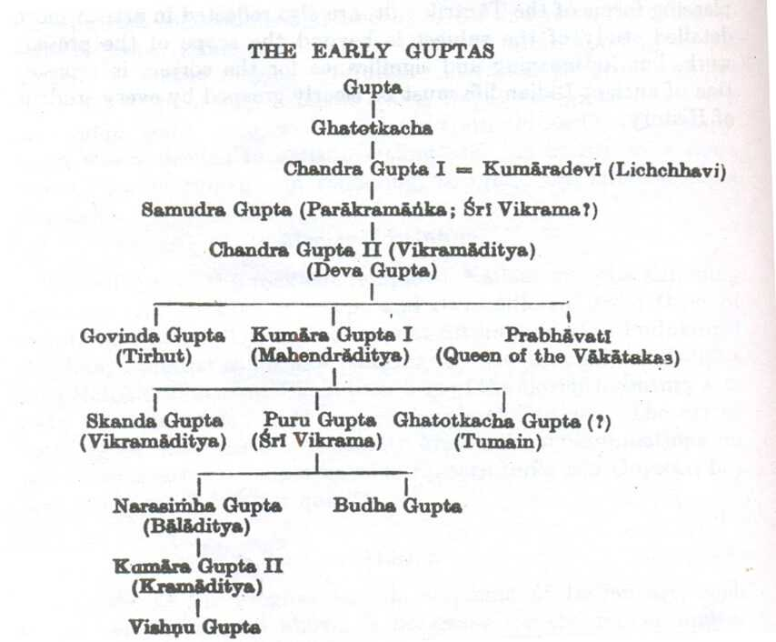
Chandra gupta 2
375 414
He is an evil ruler
He married princess omaga nag
He like-s art and literature

Slide 7
NEWIEDASNEWRELIGIONS

Slide 8
JAINISIM
Jainism’s founder Vardhamana Mahavira
Jainism life Followers of Mahavira came to be known as Jains and lead very simple lives, begging for food. They had to be honest, observe celibacy, were not allowed to steal, ect…

Slide 9
Buddhism
Founder Goutham buudha
Buddhism is one of the world's largest religions and originated 2,500 years ago in India. Buddhists believe that the human life is one of suffering, and that meditation, spiritual and physical labo

Slide 10
difference
Buddhism is centered upon the life and teachings of Gautama Buddha, whereas Jainism is centered on the life and teachings of Mahavira

Slide 11
Major Relief Features Of The World

Slide 12
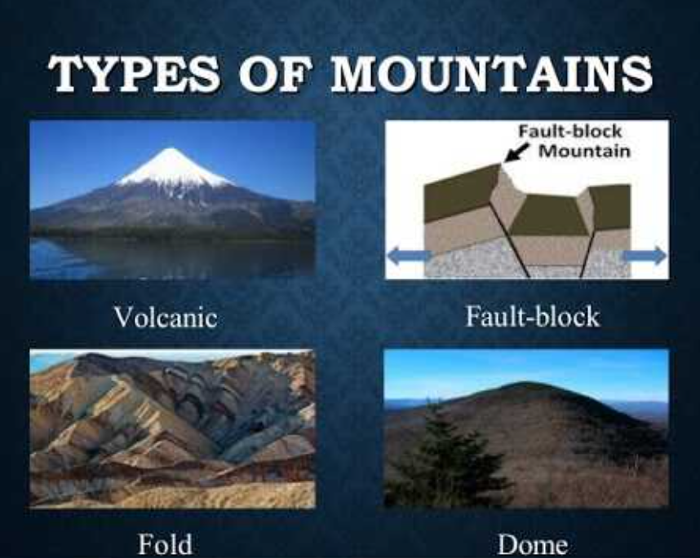
Mountain's
They have a slope and peak
Is is any natural elevation of earth's surface

Slide 13
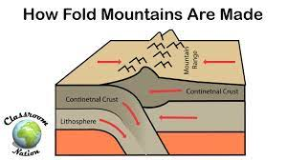
Fold mountain
It is caused by 2 tectonic plates falling e binit other one. Anticlines synclines ex-Himalayan Mountains in Asia.

Slide 14

Block mountains
It is formed because a chunk of land has misplaced from other chunk if land ex-The Rhine Valley (graben) in Germany

Slide 15
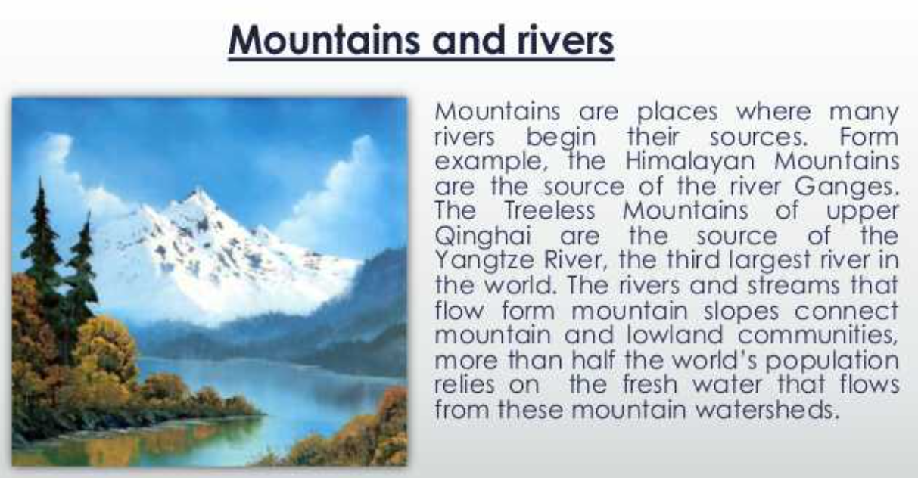


Slide 16
Volcanic mountains
When volcanoes erupt the lava solidifies and becomes Into mountaines ex-Mount Fuji in Japan

Slide 17
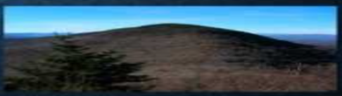
Dome mountain
Dome mountain hav aflat surface in top ex Weald in southeast England.

Slide 18
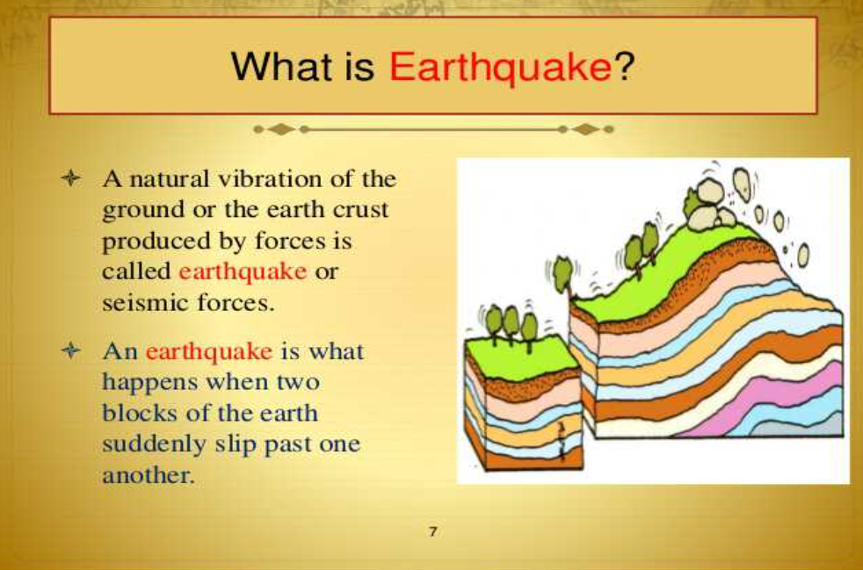
Earth qwack

Slide 19
Local self goverment

Slide 20
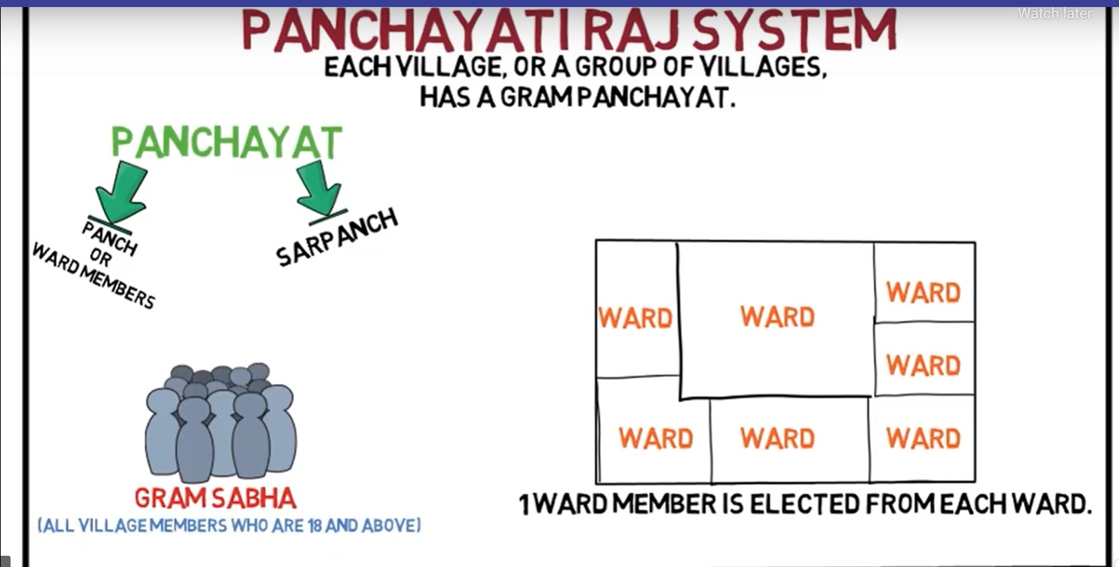

Slide 21
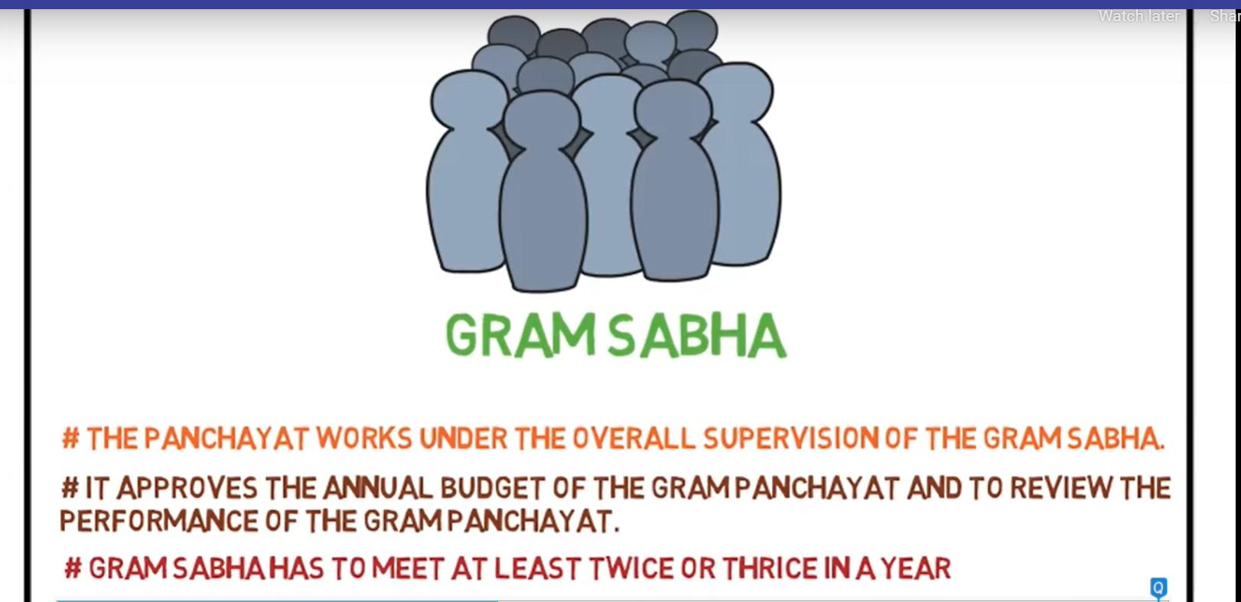

Slide 22
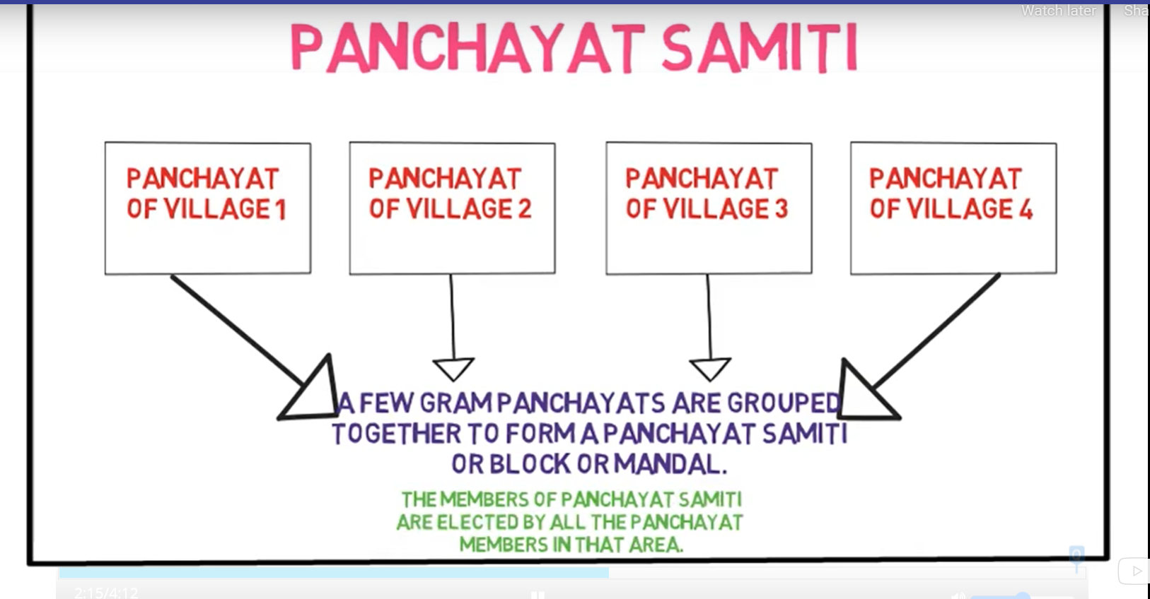

Slide 23
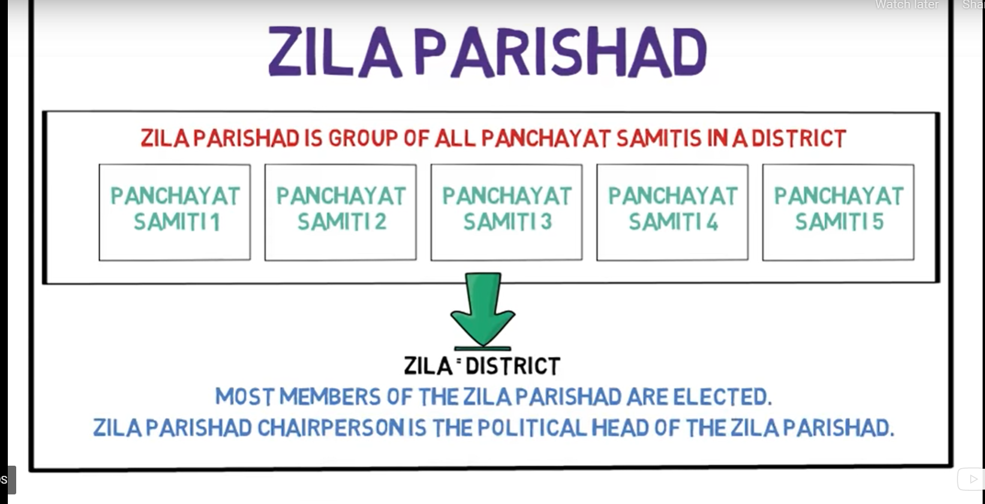

Slide 24
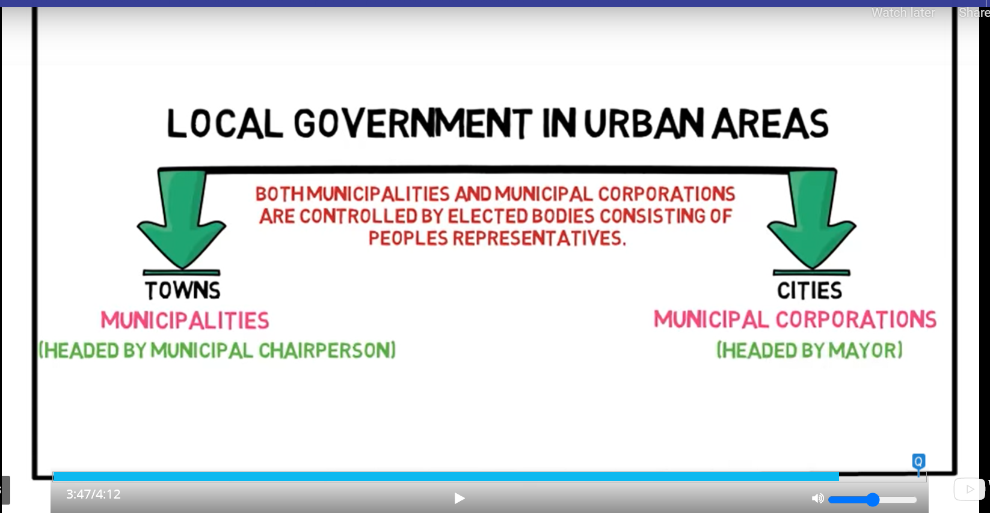

Slide 25
